Slide 1

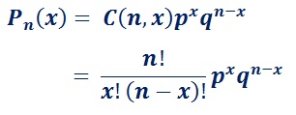
Binomial Distribution
– https://en.wikipedia.org/wiki/Binomial_distribution
The binomial distribution was discovered
by Jacob Bernoulli (1655 – 1705)
and published in 1713 (8 years after his death).
We do n independent trials with two possible outcomes
("yes" & "no") with probabilities p & q=(1-p).
Then the probability that x out of n trials have value "yes" is:
Reordering
Let’s say, we have N objects (N-element unordered set).
Question: In how many ways can we arrange them?
Answer: N!
Explanation:
N variants for the 1st element (N-1) variants for the 2nd element etc.
Example: How many ways are there to arrange the letters ABCDE in a row?
Answer: 5!=120
Subsets
Question: In how many ways can we select m-elements out of N-element set?
Answer: C(N,m) = N!/(m!*(N-m)!) – a binomial coefficient
Explanation:
N variants for the first element of subset
(N-1) for the 2nd etc.
(N-m+1) for the m-th element
The above can be written as N!/(N-m)!
Then we need to divide by the number of reordering permutations
within the subset, that is by m!
Jacob Bernoulli
(1655 – 1705)
where:
C(n,x) is binomial coefficient (Google also for Pascal Triangle)
n! = n-factorial = n*(n-1)*(n-2) ... *1
At large numbers the Binomial distribution approaches
Normal Gaussian curve with following parameters:
Mean value = Expected value E(x) = np
Variance = npq

Slide 2
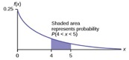
Poisson and Exponential Distributions
– https://en.wikipedia.org/wiki/Poisson_distribution
– https://en.wikipedia.org/wiki/Exponential_distribution
Suppose you are sitting near the road.
You notice that on average you see 10 cars passing by every minute
(we say: the rate lambda = 10/min).
Knowing the average rate, what would be the probability
of having only 5 cars in one minute?
Or 15 cars? Or any given number?
Poisson Probability P(k) is the probability of a given
number of events occurring in a fixed interval (of time)
if these events occur with a known average rate (usually denoted as λ = lambda)
and independently of each other
and of the time since the previous events.
Poisson Formula
P(x) = λ^{x}e^{-λ}/x!
For example, for x=0 (probability of zero events in given interval):
P(0) = (λ**0)*exp(-λ)/0! = 1*exp(-λ)/1 = exp(-λ) = e^{-λ}
Poisson Distribution
Intervals between Poisson events distributed exponentially.
If we have events happening which follow Poisson Distribution,
we can measure the time intervals between these events.
Question: How these times will be distributed?
Answer: These times will have exponential distribution
with Probability Density Function (PDF) as:
f(t) = λ*exp(-λ*t) = λe^{-λt}
The average time interval will be (1/λ).
Standard deviation happens to be the same (1/λ).

Slide 3
Uniform and Normal Distributions.
Uniform Distribution
If some value can change between some minimum and maximum
values a & b, and the probability of any value in interval [a,b]
is the same, then we say that we have uniform distribution.
The PDF (Probability Density Function) for Uniform Distribution
looks like a rectangle with the height (1/(b-a)),
so that the total area under the curve is exactly 1.
Central Limit Theorem (CLT).
The normal distribution is very common in nature.
Because when we have big number of sets of variables,
the distribution of parameters of these sets (for example, averages)
tend to converge to this bell form.
This fact is called Central Limit Theorem (CLT).
Here is a simple example of CLT:
Suppose we have N1 sets, each set has N2 values, all values drawn from the same distribution. The shape of distribution may be anything (uniform, bell-curve, triangular, exponential, etc.).
We calculate an average in each set – so we have N1 average values.
Question: How will these average values be distributed?
Answer: As N1 & N2 become big enough (30+), the distribution
will get close to the Normal Gaussian bell curve.
There are some nice animated demonstrations of CLT - just google for them.
De Moivre–Laplace theorem
De Moire-Laplace theorem is a simple demonstration how a symmetrical binomial distribution can be approximated by Gaussian bell curve (under certain conditions).
See video demonstration below.
https://en.wikipedia.org/wiki/De_Moivre–Laplace_theorem
Normal (Gaussian Bell-shaped) Distribution
The basic shape of the PDF is exp(-x*x/2)
You need to add a coefficient to normalize it to 1
(means – make area under the curve equal to exactly 1).
You can also have the curves have different position
(average value) and different width (sigma).

Slide 4
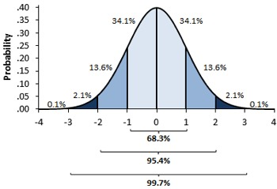
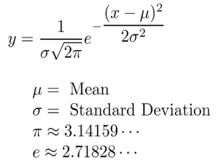
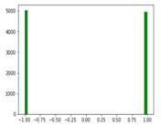
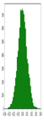
Central Limit Theorem (CLT)
We have all heard about Normal (Gaussian) distribution.
This distribution is very foundational in statistics. And it comes from CLT.
Classical CLT mathematically proves that if we calculate group averages in many groups, then the distribution of those averages converges to Normal distribution as long as we have large number of points in each group (30..100 or more) and large number of groups (30-100 or more).
Specifically, suppose we have our data points sampled from a distribution with finite average and finite variance. We subdivide this data into Ng groups, each containing Ns samples:
[...] [...] [...] [...] [...] [...] [...] [...] [...]
For each group we calculate average value of its Ns samples. Thus we have Ng averages values, and we plot them as a histogram.
If Ng and Ns are big enough, the histogram will converge to a normal distribution. This holds true regardless of the shape of the original distribution of data.
For example, suppose we have a million data points, each value is either 1 or -1 (random coin toss). We split data into Ng=10,000 groups, each sample group has Ns=10,000 data points. Then in each group we calculate the mean value (which will be close to zero).
Now we have 10,000 of mean values - and we make a histogram of those values. According to CLT it will be bell-shaped.
Expected value of abs(x) :
Expected value of x² : σ²
Here double factorial "n!!" denotes the product of all numbers from n down to 1 that have the same parity as n.
E.g. 9!! = 9*7*5*3*1, 6!! = 6*4*2

Slide 5
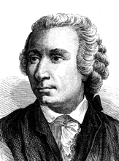
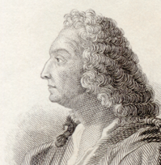
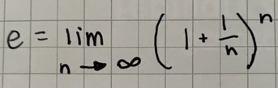
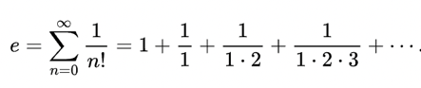
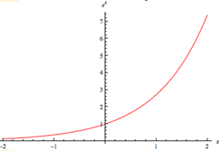
Euler's Number "e"
e = 2.7182818284590452353602874713526624977572470936999595749669676277240766303535475945713821785251664274 ...
If you invest $100 at 100% annual return, then at the end of the year you will have $200.
Total growth: 1 -> 2
If we split one year in two halves, then in first half your investment will grew by 50%. And similarly it will grew in the second half.
So total growth (1+1/2)*(1+1/2) = 2.25
Hmm, what if we split into monthly periods.
Then n=12, total growth:
(1 + 1/n)*(1 + 1/n)* ... (1 + 1/n) = 2.613
What if we split into daily periods:
n=365
(1+1/n)**n = 2.715
As we split into smaller and smaller periods,
we will approach e = 2.71828...
In 1683, Swiss mathematician Jacob Bernoulli discovered the constant e while solving a financial problem related to compound interest. He saw that across more and more compounding intervals, his sequence approached a limit (the force of interest).
In 1731, Swiss mathematician Leonhard Euler gave the number "e" its name after proving it’s irrational by expanding it into a convergent infinite series of factorials.
Exponential Function
y = e^{x}

Slide 6
How To Test if Distribution is Normal.
4. Kolmogorov Smirnov Test (KS Test) – not very good.
from scipy.stats import kstest, norm
my_data = norm.rvs(size=1000)
ks_statistic, p_value = kstest(my_data, 'norm')
print(ks_statistic, p_value)
5. Lilliefors test - like KS test, but the mean and variance are estimated rather than pre-specified by user.
Not very good test.
from scipy.stats import norm
from statsmodels.stats.diagnostic import lilliefors
my_data = norm.rvs(size=500)
lilliefors(my_data)
6. Shapiro Wilk test - the most powerful test when testing for a normal distribution.
If the P-Value of the Shapiro Wilk Test is larger than 0.05, we assume a normal distribution.
from scipy.stats import norm
from statsmodels.stats import shapiro
my_data = norm.rvs(size=500)
shapiro(my_data)
https://towardsdatascience.com/6-ways-to-test-for-a-normal-distribution-which-one-to-use-9dcf47d8fa93
1. Histogram (for a single variable).
pdseries.hist()
2. Box Plot (multiple variables), a
5-number summary of a variable:
min, first quartile, median, third quartile, max.
pdseries.plot(kind = 'box')
3. QQ Plot (Quantile vs Quantile) – plots theoretical quantiles against the actual quantiles of our variable.
import statsmodels.api as sm
from scipy.stats import norm
import pylab
my_data = norm.rvs(size=1000)
sm.qqplot(my_data, line='45')
pylab.show()

Slide 7

Example – The Matching Problem
https://www.randomservices.org/random/urn/Matching.html
An absent-minded secretary prepares N letters and N addressed envelopes,
and then randomly stuffs the letters into the envelopes.
A match occurs if a letter is inserted in the proper envelope.
What is the probability to have "k" matches ?
( 0<= k <= N )
Derangement - a permutation of the elements of a set, such that no element appears in its original position.
https://en.wikipedia.org/wiki/Derangement
Calculating number of derangements !n
(where (1/e) comes from) :
Example distribution for N = 5:
0 1 2 3 4 5
44 45 20 10 0 1

Slide 8
Binomial Distribution => Gauss
Binomial Distribution => Poisson
The Poisson distribution is a limiting case of the binomial distribution which arises when the number of trials n increases indefinitely whilst the product μ = np, which is the expected value of the number of successes from the trials, remains constant.
using Stirling’s formula:
μ = np = const, n --> inf
Poisson Distribution => Gauss
The Poisson Distribution can be approximated with Normal when λ is large (greater than 10).
1 e^{-μ} 1 Poisson
Coin tossing
x = n = λ(1 + δ) , where λ >> 1 and δ << 1
Using Stirling’s formula for n!
We are tossing a fair coin: tail = 0, head = 1
p = (1-p) = 0.5
Expected μ = p*N = N/2
For large N we approximate with Gauss
Variance σ² = Npq = N/4
Standard error σ = √ N / 2
Relative error σ / μ = (√ N / 2) / (N/2) = 1/ √ N
So If we want error ~1%, we need to do N ~ 10,000
Also for χ² calculations:
(x - μ)² / μ --> σ² / μ = (N/4) / (N/2) = ½ = const

Slide 9

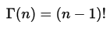

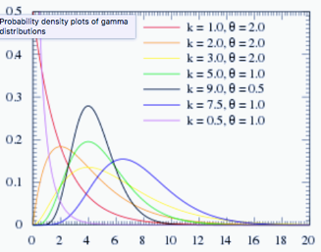
Gamma Function & Distribution
Gamma distribution: time required for "k" events to occur in a Poisson process with mean arrival time of "θ". Example: if cars are passing by every 10 seconds, how long will you wait on average to count 10 cars?
Gamma function – an extension of a factorial.
It is a smooth curve that connects the points (x, y)
given by y = (x − 1)! at the positive integer values for x.
Derived by Daniel Bernoulli and Leonhard Euler.
For complex numbers with a positive real part the gamma function is defined via the integral.
Daniel Bernoulli
(1700 - 1782)
k>0 : shape parameter
θ>0 : scale parameter
kθ = mean value
kθ² = variance
α = k : shape parameter
β = 1/θ : rate parameter
α / β = mean value
α / β² = variance
The exponential, Erlang (k=positive in), and chi-squared distributions are special cases of the gamma distribution. k = 1 : exponential distribution
k > 1 : unimodal with mode at (k-1)* θ
k →∞ , the gamma distribution approaches a normal distribution in shape.
Leonhard Euler
(1707 - 1783)
Real Part of Γ
Imaginary Part of Γ
The gamma function then is defined as the analytic continuation of this integral function.

Slide 10
Gamma Distribution Derivation
The exponential distribution predicts the wait time until the *very first* event.
The gamma distribution predicts the wait time until the *k-th* event occurs.
https://towardsdatascience.com/gamma-distribution-intuition-derivation-and-examples-55f407423840
< Notation! >
* T : the random variable for wait time until the k-th event. * Event arrivals are modeled by a Poisson process with rate λ.
* k : the 1st parameter of Gamma. The # of events for which you are waiting. * λ : the 2nd parameter of Gamma. The rate of events happening which follows the Poisson process.
* P(T > t) : The probability that the waiting time until the k-th event is greater than t time units * P(X = k in t time units) : The Poisson probability of k events occurring during t time units

Slide 11
Beta Distribution
Good Explanation
https://towardsdatascience.com/beta-distribution-intuition-examples-and-derivation-cf00f4db57af
Beta distribution is similar to binomial, but :
in binomial the probability is a parameter
in beta the probability is a random variable
Beta has two parameters (α, β):
α-1 - number of successes
β-1 - number of failures
As α becomes larger (more successful events), probability distribution will shift towards the right,
whereas an increase in β moves the distribution towards the left (more failures).
If α-1 is the number of successes and β-1 as the number of failures, then Beta(2,2) means you got 1 success and 1 failure. So it makes sense that the probability of the success is highest at 0.5.
Also, Beta(1,1) would mean you got zero for the head and zero for the tail. Then, your guess about the probability of success should be the same throughout [0,1]. The horizontal straight line confirms it.
The Beta distribution is the conjugate prior for the Bernoulli, binomial, negative binomial and geometric distributions (seems like those are the distributions that involve success & failure) in Bayesian inference.

Slide 12
Moments of a probability distribution
used to characterize its position and shape
0th moment = total probability ( = 1)
1st moment = expected value
central moments = moments around the mean
standardized moment = normalized moment
2nd central moment = variance
3rd standardized moment is the skewness
4th standardized moment is the kurtosis

